Slide 1
Public Information Session
Wednesday, August 2, 2023 | 7PM
Dublin Town Hall, Basement, 1120 Main Street, Dublin, NH 03444

Slide 2
What is Community Power?
New Hampshire cities, towns, and counties can become default electricity provider for their residents + businesses and provide related services.
Pooled Purchasing Power
for Energy Supply
Utility Company
Delivers Power
Communities Benefit from Value Added Services & Programs
Lower Rates & Product Choices
Economies of Scale
Grid Reliability
RSA 53-E, Relative to Aggregation of Electric Customers by Municipalities & Counties
Customers may switch back to utility default supply or take service from a Competitive Supplier
Community Power programs must be paid for out of revenues received from participating customers
Notes:
Doria

Slide 3
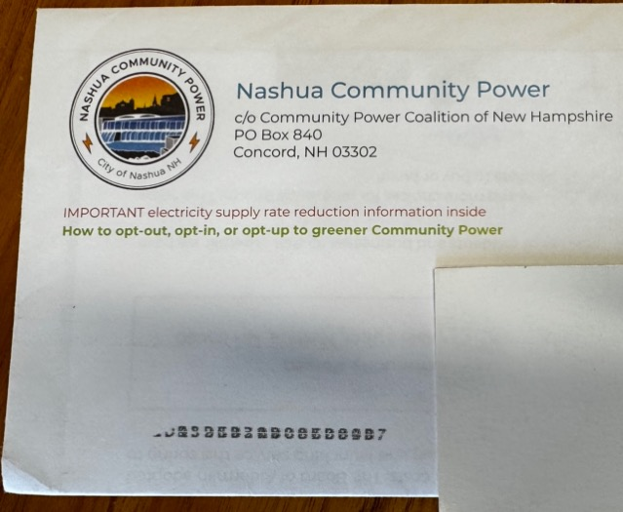
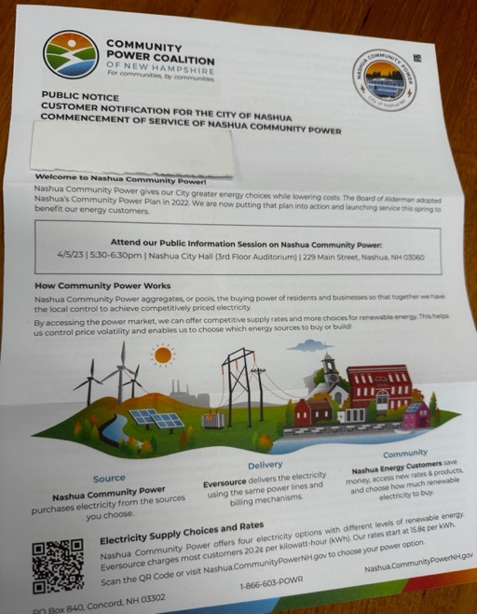
Customer Notification and Enrollment Process
At least 30 days before program launch all electric customers will be mailed notifications including the initial fixed rate for Community Power service compared with Eversource
Customers on Eversource default energy service able to decline participation or “opt-out” by calling 1-866-603-POWR, contacting info@CommunityPowerNH.gov ; or visiting www.CommunityPowerNH.gov
If a customer is already getting their power from a competitive supplier, nothing will change unless they choose to “opt-in” to Community Power.
Eversource will continue to deliver electricity using their poles and wires, provide billing services, and ensure reliability.
Rates posted at least 30 days in advance; customers can switch supplier at next meter read upon request with no penalty or exit fee.
Community Power is self-funded by rates paid by participating customers. No taxes will be used to cover program expenses.

Slide 4
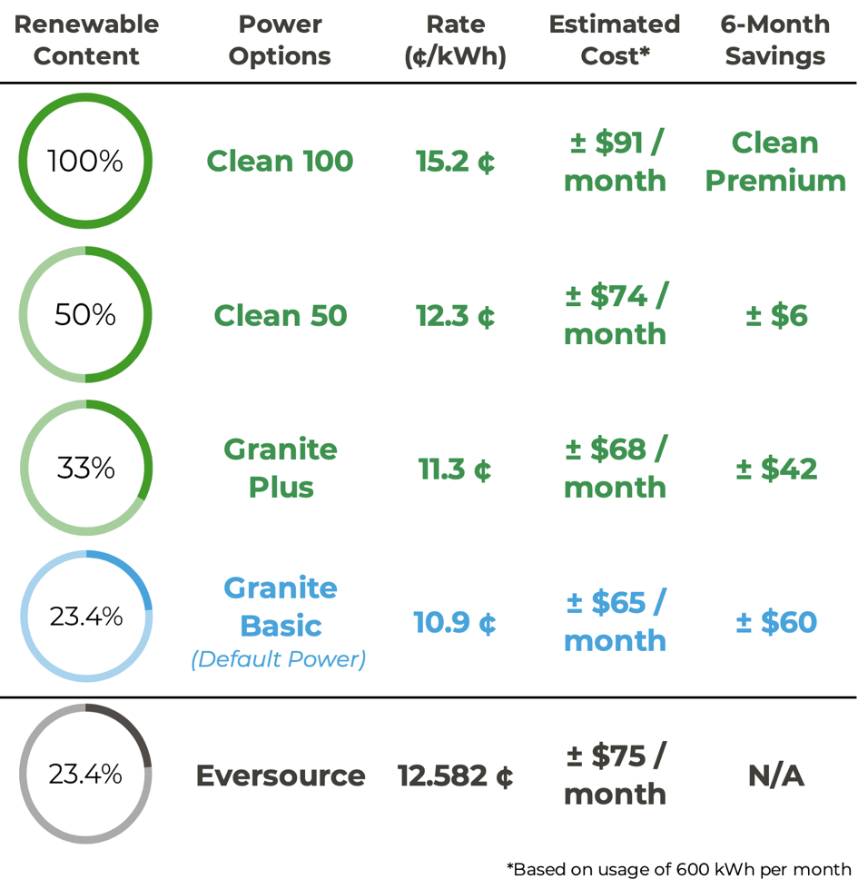
Electricity Choices
Aug 1, 2023 – Jan 31, 2024
Energy customers can select from a menu of energy choices.
Visit www.CommunityPowerNH.gov and use the portal, or call 1-866-603-POWR, to select your power option.
Please have your utility account number handy so your selection may be easily processed.
Customers are always free to choose to buy power from their utility, or from another market option, without charge.

Slide 5
Electricity Choices — Mid-Sized Commercial
Cheshire Community Power monthly variable rates for Primary General Service customers (Class GV) enrolled into Granite Basic compared to Eversource's supply rate in ¢ per kWh:
Mid-sized commercial customers (Class GV) can also pay an additional 0.4¢ / kWh, 1.1¢ / kWh or 3.3¢ / kWh to opt-up to Granite Plus, Clean 50, or Clean 100

Slide 6
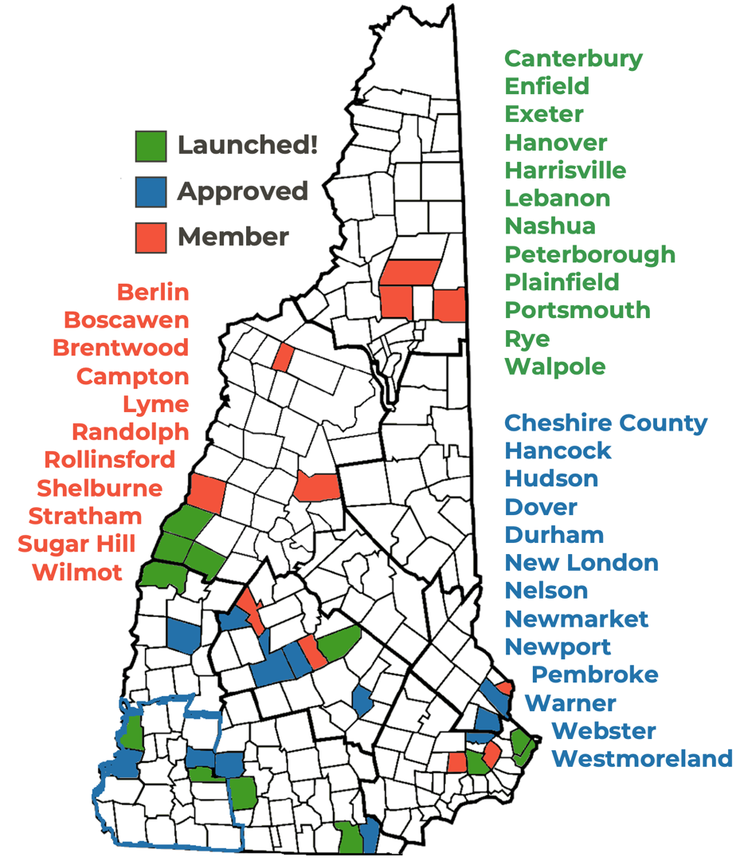
Community Power Coalition of NH
Community-governed power supplier
Our Mission
To foster resilient New Hampshire communities by empowering them to realize their energy goals.
Nonprofit Joint Power Agency formed 10/1/21
34 Members | 23% of NH population
12 of 33 Members launched spring 2023
~75,000 customers
~400,000 MWh in 2023 (APR – DEC)
~$51 million 2023 revenues (controlled by communities)
Remaining & new Members to launch 2024+
All NH cities & towns are invited to join

Slide 7
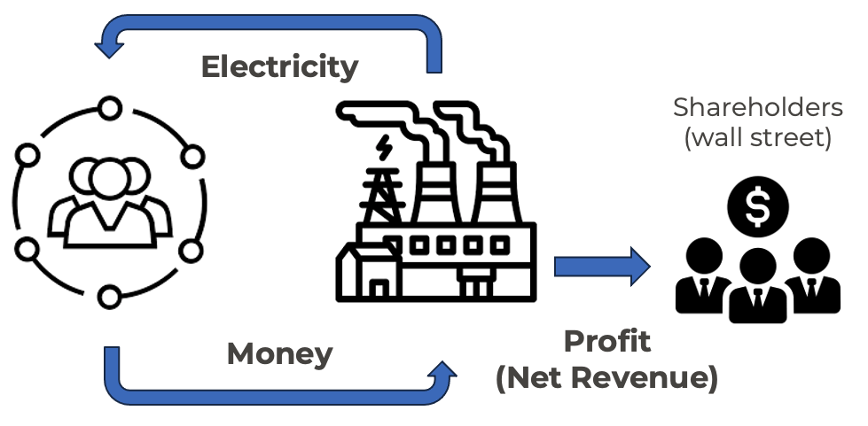
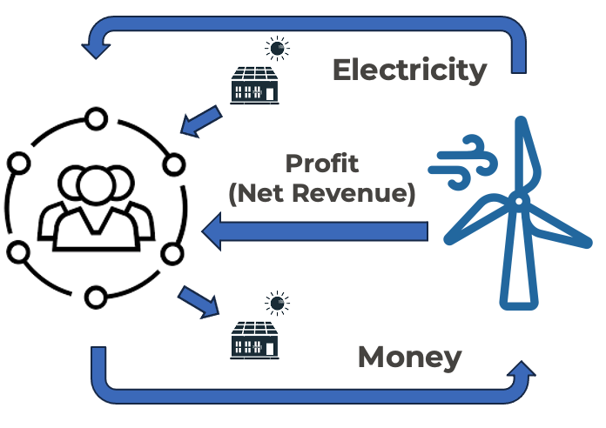
Comparing Models of Electricity Cashflow
Legacy/Broker Model
CPCNH Model

Slide 8
Board of Directors
Community Governance
Staff & Service Providers
Expert Operations
Board Committees
Audit
Executive
Finance
Governance
Member Outreach & Engagement
Regulatory & Legislative Affairs
Risk Management
CEO
Brian
Callnan
Energy
Portfolio Mgmt
Retail Customer Services
Community Engagement
Legal
Start-up
Consultants
Revenue Controls & Accounting
Local elected officials, former utility executives, energy finance & development professionals, municipal managers, teachers, & much more.

Slide 9
Streamlined County Model for Cheshire Towns
Join Cheshire Community Power → Launch!
1. Select Board vote to Join Cheshire Community Power
Appoint representative to Governance Council
2. Launch Community Power!
Launch of service and benefits for customers with 45 to 90-days advanced notice to utility companies
Notes:
Samuel

Slide 10
Cheshire EAP Attachment 9
Process to Join Cheshire Community Power
Any municipality within the county may, by majority vote of their governing body pursuant to RSA 53-E:6, request to join Cheshire Community Power by adopting and submitting the resolution provided below to the County Commissioners for their review and approval:
Resolved, that we hereby commit the Town of [INSERT] to join Cheshire Community Power to provide default supply service on an opt-out basis to retail electricity customers within the Town’s boundaries, pursuant to RSA 53-E:6(I), understanding that the Town may appoint a representative and alternate to the Cheshire Community Power Governance Council to support joint oversight of the program, and continuing hereafter, or until such time as the Town elects to form its own Community Power Aggregation program, as provided for in and subject to the terms of the County’s Electric Aggregation Plan, inclusive of the requirements and considerations for municipalities afforded therein under Attachment 10: Cheshire Community Power Governance Council, as amended from time to time hereafter.

Slide 11
Cheshire EAP Attachment 10
Cheshire Community Power Governance Council
Joining towns appoint voting representation to Governance Council
Establishes transparent, participatory, flexible decision-making structure for mutual advantage of the participating municipalities and the County.
Governance Council duties and function:
Ensure engaged and informed governing bodies of participating communities
Encourage and support expansion of program to interested communities
Designating individuals for the County Commissioners to appoint as the representatives and ”Authorized Officer” to CPCNH
Authorizing individuals to serve on committees of CPCNH on behalf of the program
Recommending amendments to the Electric Aggregation Plan for consideration by the County Commissioners
Approving the withdrawal of municipalities from the program that have subsequently elected to implement their own Community Power Program
Assuming additional duties at the Council’s discretion to develop and enable voluntary, cost effective, and innovative solutions to local needs with careful consideration of conditions and opportunities across the County pursuant to this Electric Aggregation Plan

Slide 12
Community Benefit: Savings + Reserves
Cheshire Community Power creates savings, rate stability, value for customers by developing beneficial local energy projects and programs
>$20 Million in value in CPCNH’s first year (Apr – Dec 2023):
~$10 Million in immediate customer bill savings
~$10 Million in community reserves for long-term benefit
Cheshire Community Power sets rates with the objective of saving you money and offering at least one supply option at a discount relative to your utility supply rate (along with ‘opt up’ choices). Most utility rates are set from February 1 to July 31, 2023. Our default rates will change for the next utility rate period, scheduled from August 1, 2023 through January 31, 2024.
Rates are set through Community Power Coalition of New Hampshire, the public non-profit governed by NH cities, towns and counties, including Cheshire County. All future default rate changes will be publicly noticed at least 30 days in advance at CommunityPowerNH.gov and at:
https://www.energy.nh.gov/engyapps/ceps/shop.aspx.

Slide 13
Long-term Benefits

Slide 14
Community Representation
Cheshire joined 33+ other cities and towns to create our own locally accountable nonprofit power agency: Community Power Coalition of NH.
Cheshire Community Power appoints representatives to the Coalition’s Membership, Committees, and Board elections to oversee the agency’s governance and finances.
Terry Clark
Cheshire County
Commissioner

Slide 15
Customers Ineligible for Automatic Enrollment
Certain customer groups will NOT be automatically enrolled in Cheshire Community Power, including:
Customers buying electricity from a third-party supplier.
Net Metered customers.
Large General Service (Class LG), Backup Service (Class B) and Commercial & Industrial electric vehicle charging station customers (Class EV-2).
If one of these exceptions applies to you, contact us at info@CommunityPowerNH.gov or by calling 1-866-603-POWR to discuss your options.

Slide 16
Key Points
Most Eversource default electric supply customers will be automatically enrolled upon program launch in the same service for a lower price. Cheshire Community Power will be the new default electricity supplier for customers in participating towns.
Participation in Community Power is voluntary. Customers can choose to opt-out and to stay with Eversource for electric supply, or shop for another market option.
Eversource will continue to deliver electricity using their poles and wires, provide billing services, and ensure reliability.
Customers shopping with third-party suppliers will remain with their supplier unless they choose to opt-in to Cheshire Community Power.
Cheshire Community Power is self-funded by rates paid by participating customers. No taxes will be used to cover program expenses.

Slide 17
Questions & Answers
1-866-603-7697 (POWR)
info@CommunityPowerNH.gov
CommunityPowerNH.gov
Interested in supporting efforts to remove policy and regulatory barriers to developing local energy projects that lower costs and benefit our local economy?
Join our Community Leader Subscribers List at www.cpcnh.org/community-leader-sign-up

